Slide 1
Visitor
Visitor Design Pattern
Group 09
Võ Trần Thanh Lương
Tô Minh Thành
Nguyễn Trần Trọng Tâm

Slide 2
Contents
Problems and normal solutions
Visitor Design Pattern
Solving the problem using pattern
Similar problems
Pros and Cons

Slide 3
Problems and normal solutions

Slide 4
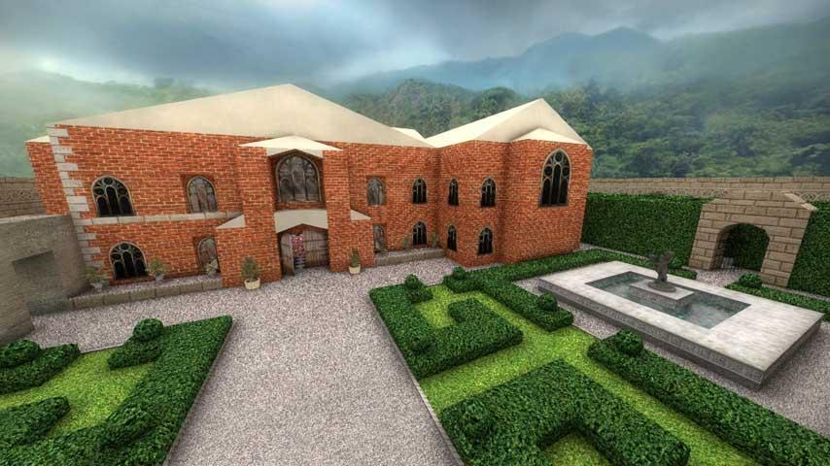
Problem

Slide 5
Normal solution
Solution:
Trying to modify the predefined structure when a new feature is needed.
Problem with this solution:
Expensive and inefficient since modifications rare required constantly.

Slide 6
Solving the problem using pattern

Slide 7
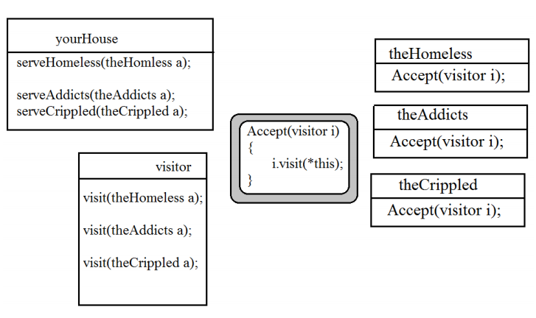
Look again at the problem

Slide 8
Visitor Design Pattern

Slide 9
Visitor Design Pattern
Definition (by the Gang of Four):
“A way of separating an operation from an object structure on which it operates…”
Main purpose:
Add new methods to a class without having to modify the source.

Slide 10
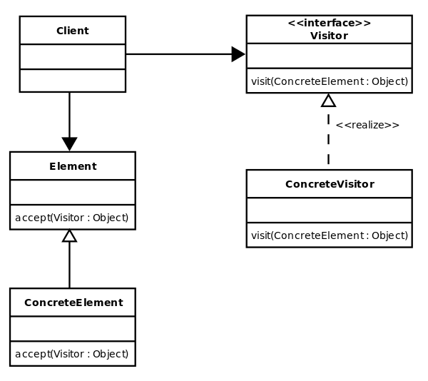
Structure

Slide 11
Similar problems
Most of OOP languages support single dispatch, or virtual method
class SpaceShip {
virtual string GetShipType() {
return "SpaceShip";
}
}
class ApolloSpacecraft : SpaceShip {
virtual string GetShipType() {
return "ApolloSpacecraft";
}
}
Int main(){
SpaceShip ship = new ApolloSpacecraft();
cout<<ship.GetShipType()<<endl;
}
Ouput on the screen would be
ApolloSpacescraft;

Slide 12
But suppose you have something like this :
class Asteroid {
virtual void CollideWith(SpaceShip ship) {
cout<<"Asteroid hit a SpaceShip";
}
virtual void CollideWith(ApolloSpacecraft ship) {
cout<<"Asteroid hit an ApolloSpacecraft");
}
};
class ExplodingAsteroid : Asteroid {
void CollideWith(SpaceShip ship) {
cout<<"ExplodingAsteroid hit a SpaceShip";
}
void CollideWith(ApolloSpacecraft ship) {
cout<<"ExplodingAsteroid hit an ApolloSpacecraft";
}
};
Int main() {
Asteroid theExplodingAsteroidRef = new ExplodingAsteroid();
SpaceShip theApolloSpacecraftRef = new ApolloSpacecraft();
theExplodingAsteroidRef.CollideWith(theApolloSpacecraftRef);
}
ExplodingAsteroid hit a SpaceShip

Slide 13
Pros and Cons

Slide 14
Pros
Allow additional operations to be operated on structure without having to modify the structure itself.
Allow the result of implementation to depend on both the the return data type and the parameter type.

Slide 15
Cons
Additional implementation is required.
If visitor pattern was not intended, modification is required.

Slide 16
THANK YOU FOR YOUR ATTENTION

Slide 17
References
https://sourcemaking.com/design_patterns/visitor
https://www.codeproject.com/articles/588882/the-visitor-pattern-explained

